Slide 1

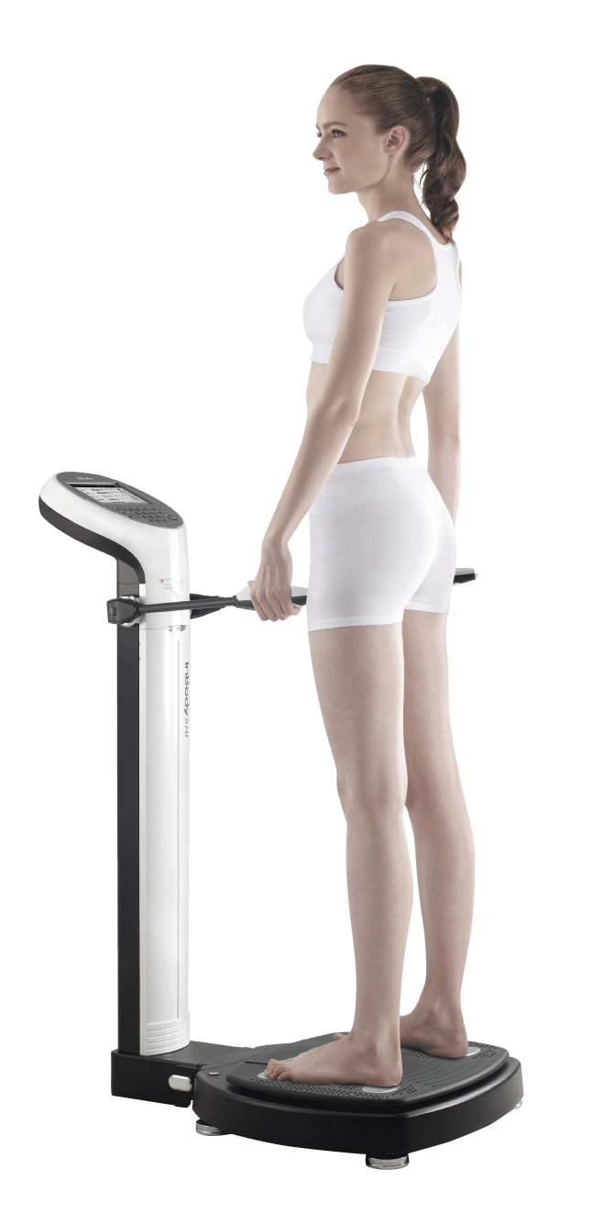
Application of Body Composition Analysis in Diabetes
Ms. Sakshi Mhatre
Clinical Dietitian
InBody India

Slide 2

What is type 2 Diabetes Mellitus ?
Energy Source
Diabetes mellitus (DM) is a metabolic disease, involving inappropriately elevated blood glucose levels.
Type 2 Diabetes Mellitus is one of the most common metabolic disorders caused by a combination of two primary factors :
Defective insulin secretion by pancreatic β-cells
Inability of insulin-sensitive tissues to respond appropriately to insulin.
Glucose Imbalance
Diabetes Mellitus
Sapra A, Bhandari P. Diabetes Mellitus. [Updated 2022 Jun 26]. In: StatPearls [Internet]. Treasure Island (FL): StatPearls Publishing; 2023 Jan-. Available from: https://www.ncbi.nlm.nih.gov/books/NBK551501/

Slide 3
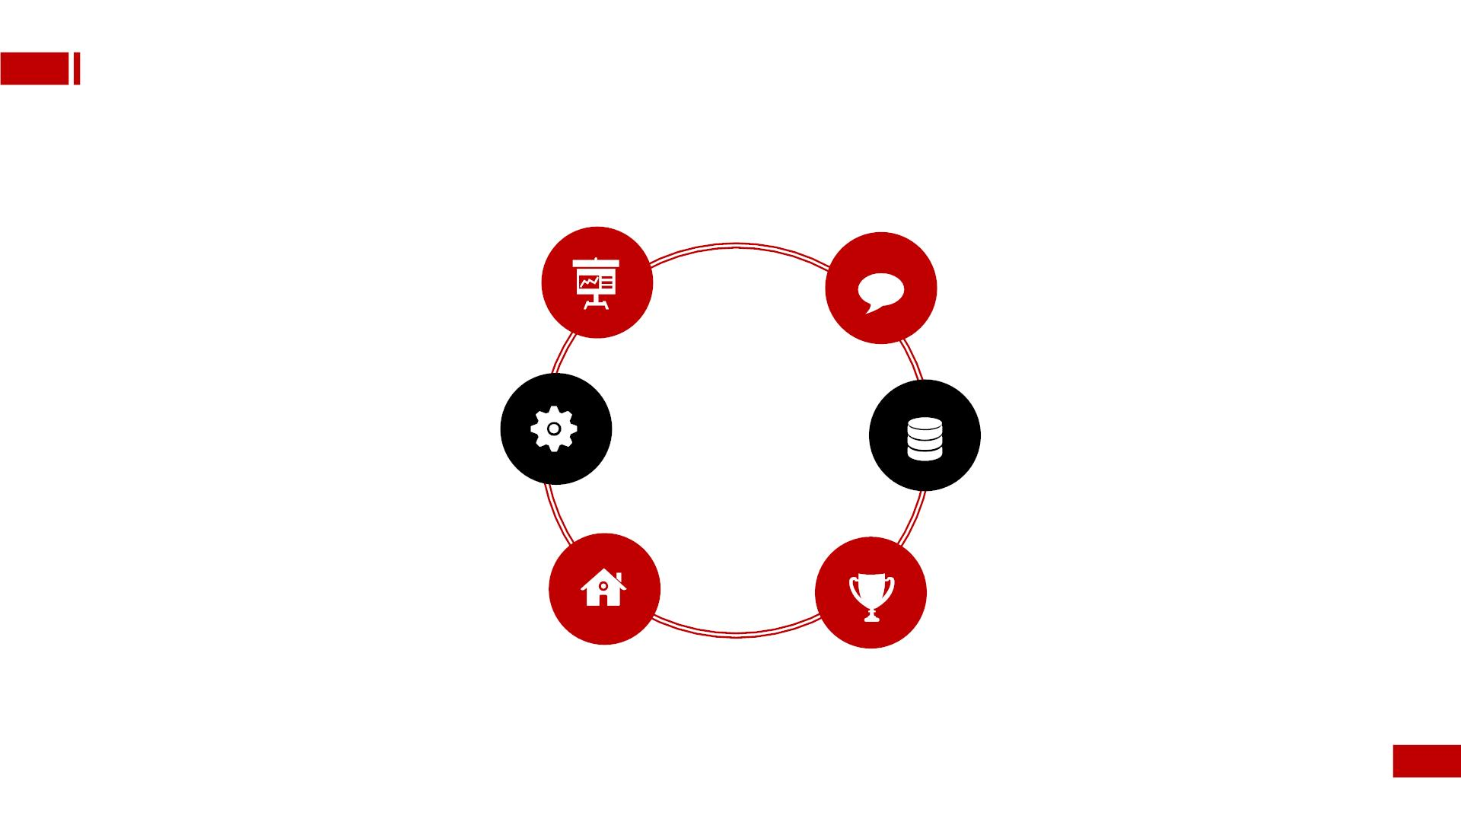
Diabetes Monitoring
BUT, is it enough?
HbA1c Test
(6.5 above)
Weight
Fasting Plasma Glucose
Waist circumference
(126 or above)
Oral Glucose Tolerance Test
(200 or above)
Blood Pressure

Slide 4
Points of focus!
Muscle Mass
Visceral Fat
ECW Ratio

Slide 5
Muscle Mass and Diabetes

Slide 6
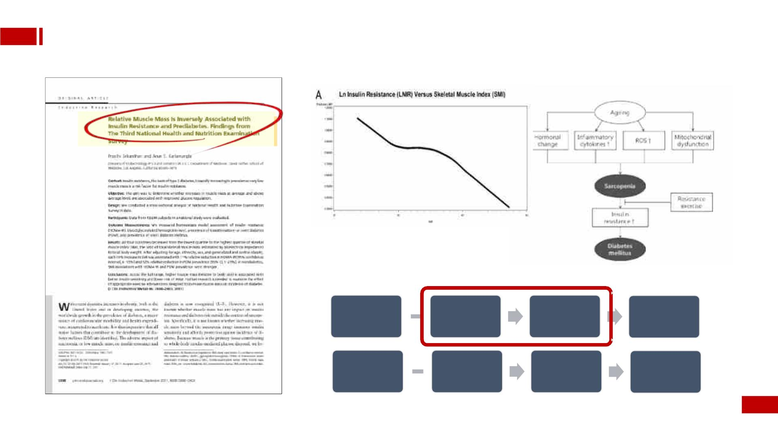
About Diabetes-Muscle
Everyꢀ10%ꢀincreaseꢀinꢀ
muscleꢀmassꢀresultsꢀinꢀaꢀ
decreaseꢀinꢀinsulinꢀ
J Clin Entocrinol Metab, 2011
resistanceꢀbyꢀ11%.ꢀ
Healthy
people
Low
Muscle
Insulin
Resistance↑
Diabetes
Healthy
people
High
Muscle
Insulin
Resistance↓
Prevent
Diabetes

Slide 7
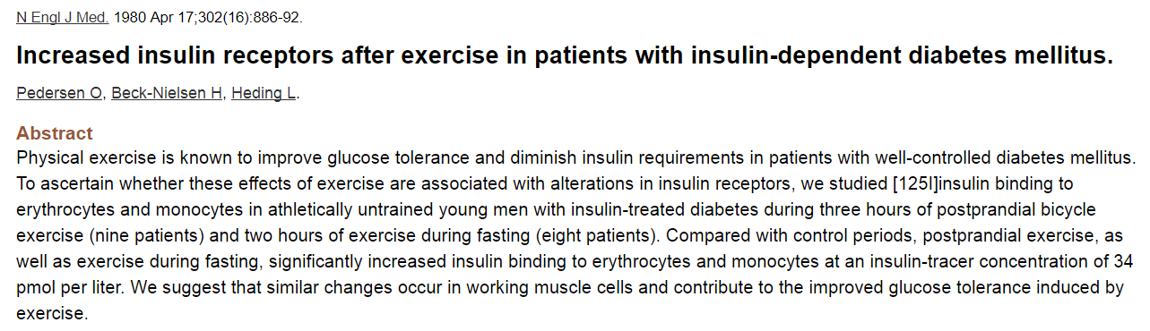
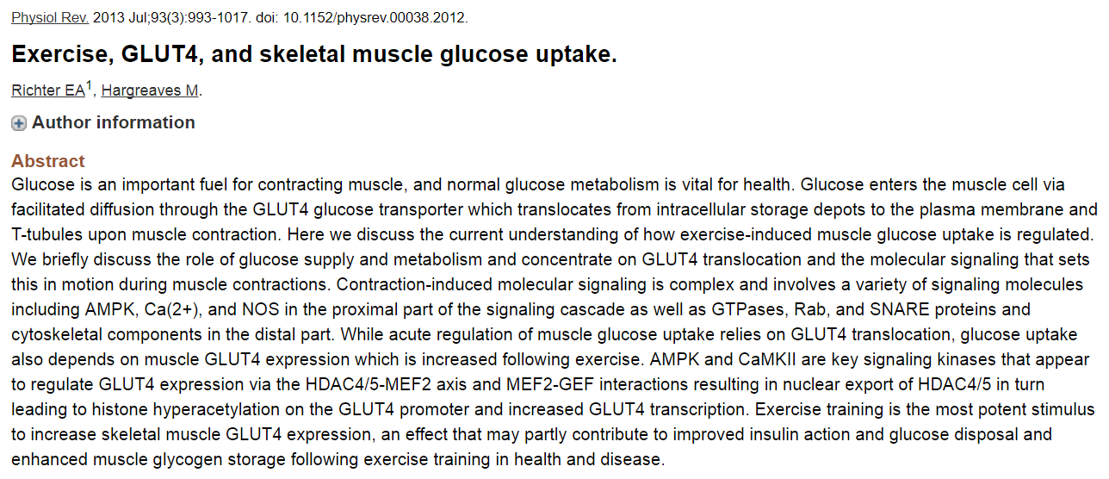
Muscle Mass and Diabetes
(N Engl J Med. 1980 Apr 17;302(16):886-92 / Physiol Rev. 2013 Jul;93(3):993-1017)
 | Insulin Receptor | GLUT4 (Glucose transporter type 4)
Characteristics | Located in the plasma membrane Adipocytes, Hepatocytes, Skeletal muscle Organ cells… | Located in the plasma membrane Skeletal muscle, Cardiac muscle, Adipose Tissues Insulin-regulated glucose transporter
Notes:
운동 후 GLUT4, Insulin receptor expression이 증가
근육량이 늘어나면 이들의 발현이 더욱 증가할 수 있기 때문에 근육량이 많은 경우 Insulin sensitivity가 증가한다고 말하는 것이고
이런한 증거들이 많음.
인슐린이 인슐린 리셉터가 글룻4가 경로가 되는 단백질
포도당이 줄어들려면 혈액속에 있는 포동아이 들어와야 낮아지는데
포도당이 세포안으로 들어오기 위해서 글룻 4의 통로가 열려야 함.
열기 위해서는 인슐린이 리셉터에 접함이 되어야 하고,
그 시그널이 열리지 않는 경우가 두번째 케이스.
근육이 중요하다하라고 얘기하는데
왜 중요한지 보는게 이 슬라이드
인슐린 리셉터나 글룻4는 혈당 조절에 중요한 역할을 하는데 이 두개가 골격근에 주로 분포하고있음.
그리고 실제로 운동을 해서 근육량이 늘어난 사람들, 머슬셀 표면에 위치하고 있어, 머슬이 늘어났을 때 발현도 늘어남
근육이 많아지면 인슐린 리셉터 글룻4도 늘어가고 혈당 조절도 쉽게 됨.
그래서 근육이 중요하다고 얘기하는 것이고, 뒷받침 해주는 근거가 있다.

Slide 8

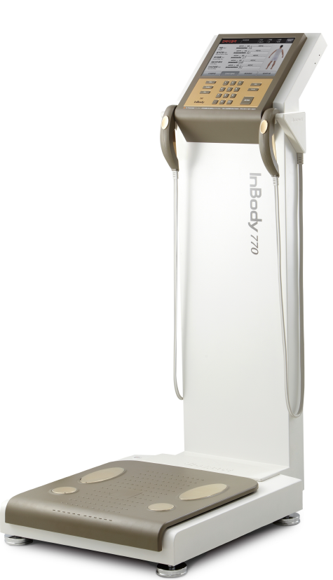
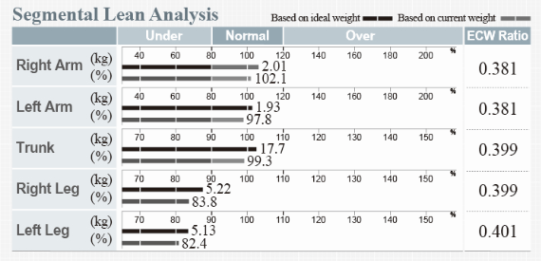
Muscle Mass and Diabetes
Body Composition |  | Symptoms | Parameter provided by InBody | Application
Screening | Risk of Diabetes | Low Muscle | SMM (Skeletal Muscle Mass) | Insulin resistance(sensitivity) related to low muscle mass
Monitoring | Muscle Wasting Disease | Muscle Decrease | SMI (Skeletal Muscle Index) | Sarcopenia Evaluation
Measurement
SMI = Appendicular Lean(RA + LA + RL + LL) / Height²
Notes:
그렇기 떄문에 우리는 근육량을 통해 당뇨의 위험을 Screening하고,
당뇨인 환자들의 근육량이 줄어들지 않도록, 저근육증이 오지 않도록 인바디를 통해 관리해야한다고 말할 수 있는 것이다.

Slide 9
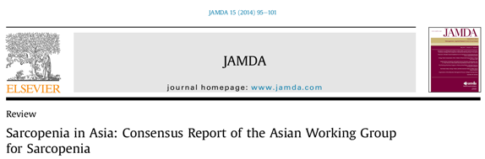
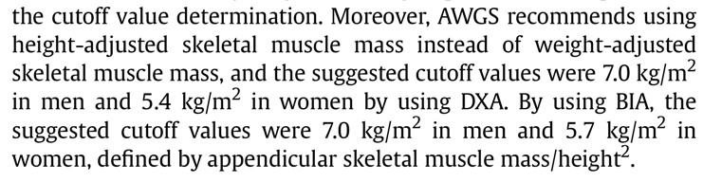
Muscle Mass and Diabetes
(J Am Med Dir Assoc. 2014 Feb;15(2):95-101)
Cut-off for Sarcopenia (Asians)
* SMI(Skeletal Muscle Index) = Appendicular Skeletal Muscle Mass/height²
Cutoff value : Male : 7.0 kg/m² / Female : 5.7 kg/m²
Notes:
Journal of American Medical Directors Association

Slide 10
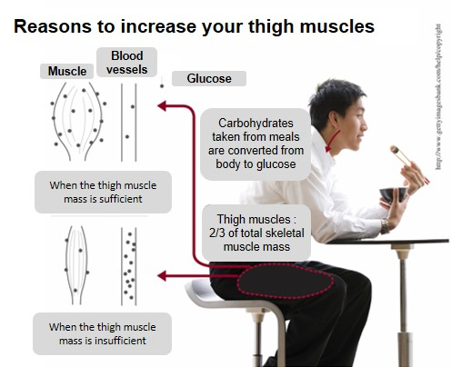
Muscle Mass and Diabetes
Leg Muscle and Diabetes
Low leg muscle
Muscle weakness
Physical Activity ↓
Muscle loss
Insulin resistance ↑
Notes:
전신 근육량과 골격근량을 모니터링하는 것도 중요하지만 그 중 다리 근육량을 집중적으로 모니터링 하는 것도 필요하다
왜? 전체 근육의 2/3를 차지하고, 많은 양을 차지하는 많은 Glucose clearance에 더 많이 관여
실제 연구들에 따르면 많은 당뇨 환자들에게서 low leg muscle을 보이고 실제
허벅지 근육이 중요한데, 근육이 혈당을 저장하는 역할을 해주는 곳인데
허벅지의 경우에는 총 근육량의 2/3를 차지하고 있다.
허벅지 근육이 많으면 면적도 넓다보니 혈당이 높아졌을 때 저장을 더 많이 할 수 있다.
허벅지 근육이 줄어들면 반대의 효과

Slide 11
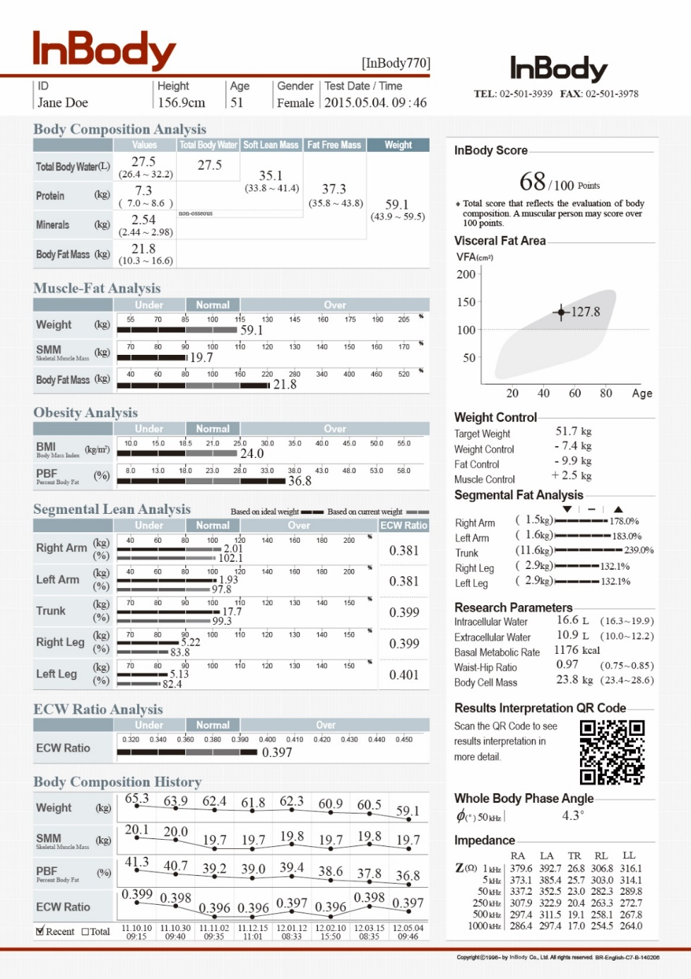
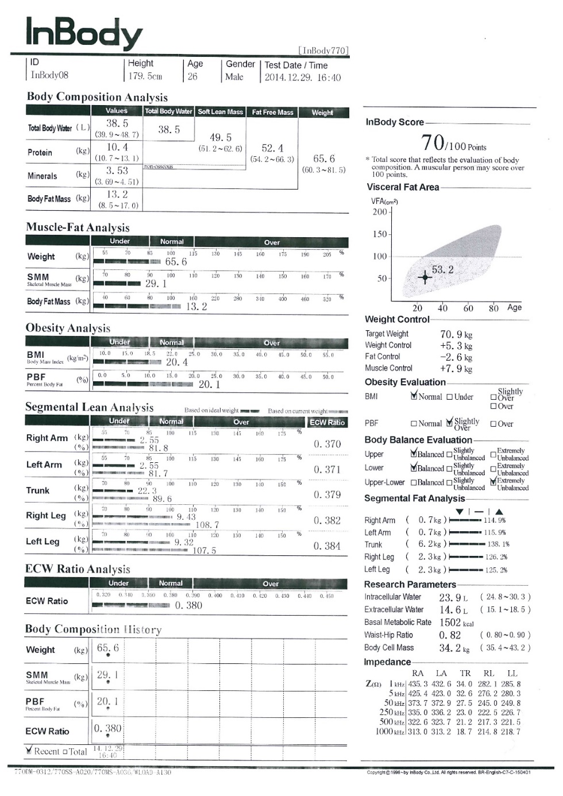
Muscle Mass and Diabetes

Slide 12
Visceral Fat and Diabetes

Slide 13
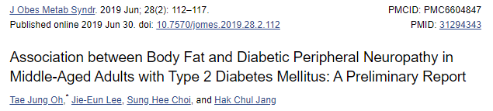
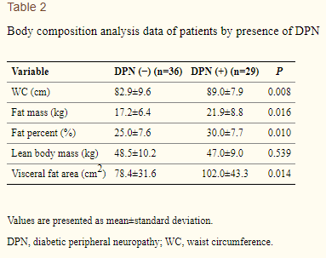
Body Fat and Diabetes Complication
Conclusion
Abdominal obesity was associated with DPN. Insulin resistance might mediate obesity and DPN in middle aged subjects with T2DM.
Table 2 shows body composition data (InBody 770). WC, fat mass, fat percent, and visceral fat area were significantly increased in the DPN (+) group than the DPN (−) group. However, lean body mass was not different between groups.
https://www.ncbi.nlm.nih.gov/pmc/articles/PMC6604847/

Slide 14
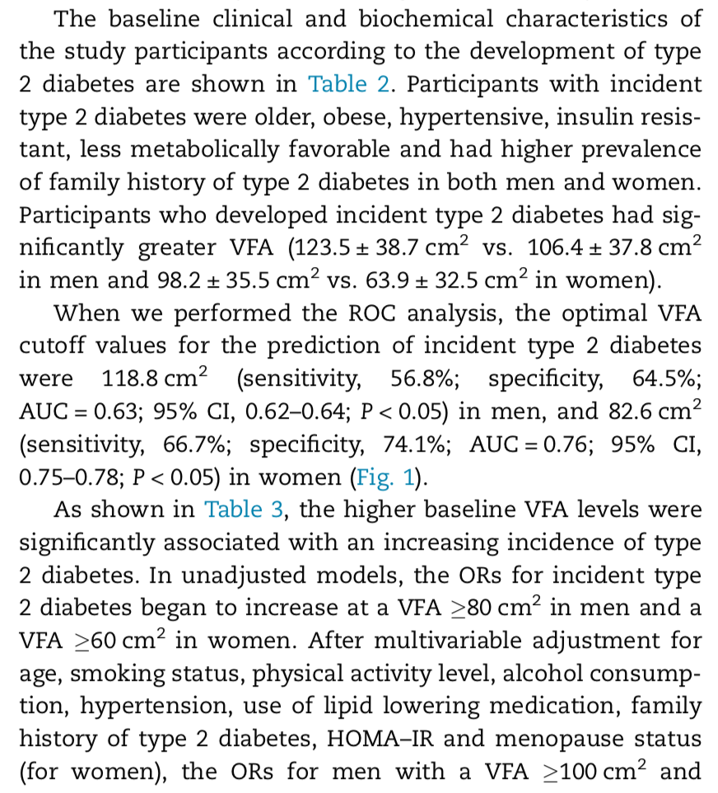
Visceral Fat and Diabetes

Slide 15
ECW Ratio

Slide 16
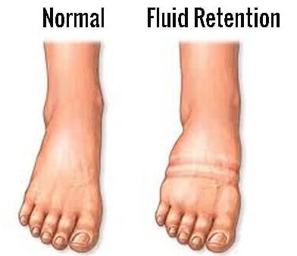
Water Retention
Screening water accumulation in whole and segmental(arms, legs, trunk) parts.
Diabetes damages body vessels and makes them leaky. As a result, fluid starts to leak out of them, which leads to fluid retention or edema
Human body is made up with 50~70% of body water composed of intra- cellular water(ICW) and Extra-cellular water(ECW). ICW is water inside muscle, ECW is sum of water in blood and interstitial fluid. The ratio of ICW:ECW is 62:38 in healthy people. Many people suffering from diabetes complain about swelling in legs and feet. Chronic swelling and poor blood flow may often lead to the ulcers or infections of legs, foot or ankle. Therefore, it can be needed to monitor ECW ratio of legs.

Slide 17
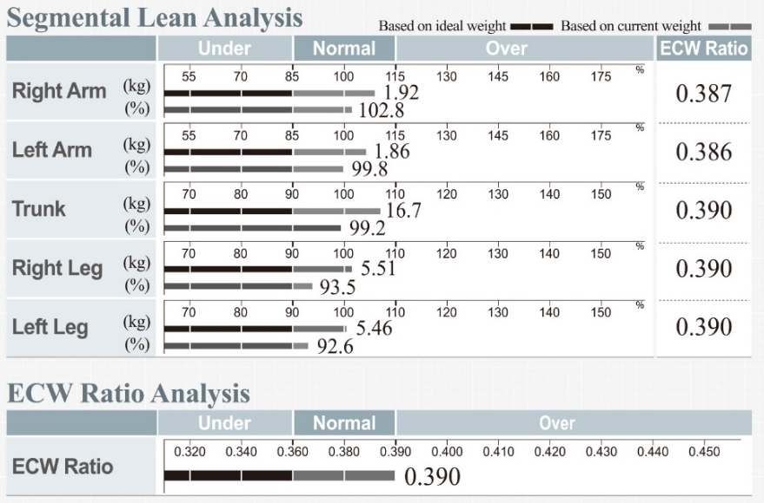

Diabetes, 60y, female
Whole ECW ratio and ECW ratio of trunk and legs are over 0.390.
Many diabetic patients tend to have slightly high ECW ratio.
Diabetes, 80y, male
Whole ECW ratio is normal.
But, ECW ratio of left leg is over 0.390.
Legs are moving part at the same time. It is difficult to show high ECW ratio in one side.
→ Possibility of Edema

Slide 18
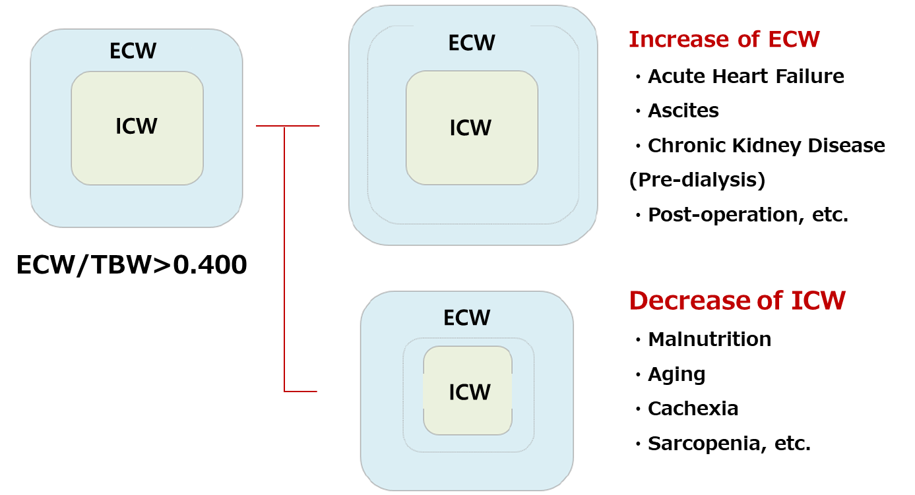
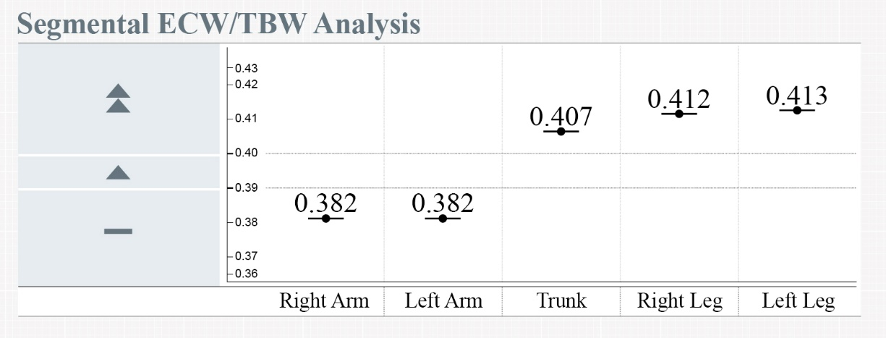
ECW Ratio & Diabetes Complications
Using the ECW ratio for early screening of diabetic nephropathy, one of the highest complication in diabetes.
Diabetes is slowly emerging one of the leading causes of chronic kidney disease. When the kidney is damaged, it cannot filter blood properly, resulting in retention of fluids.

Slide 19

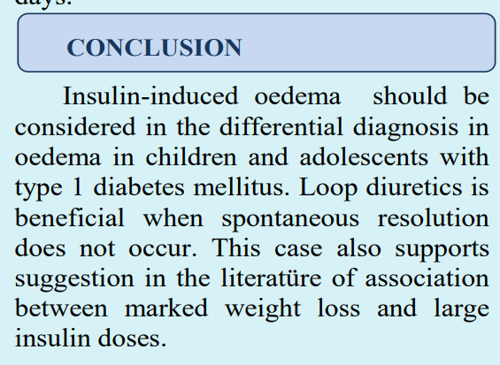
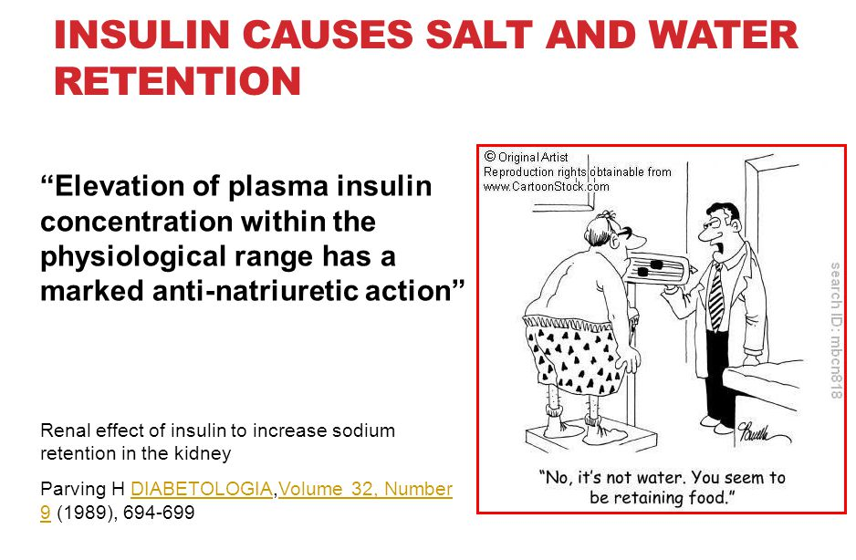
https://abstracts.eurospe.org/hrp/0092/eposters/hrp0092p3-65_eposter.pdf

Slide 20
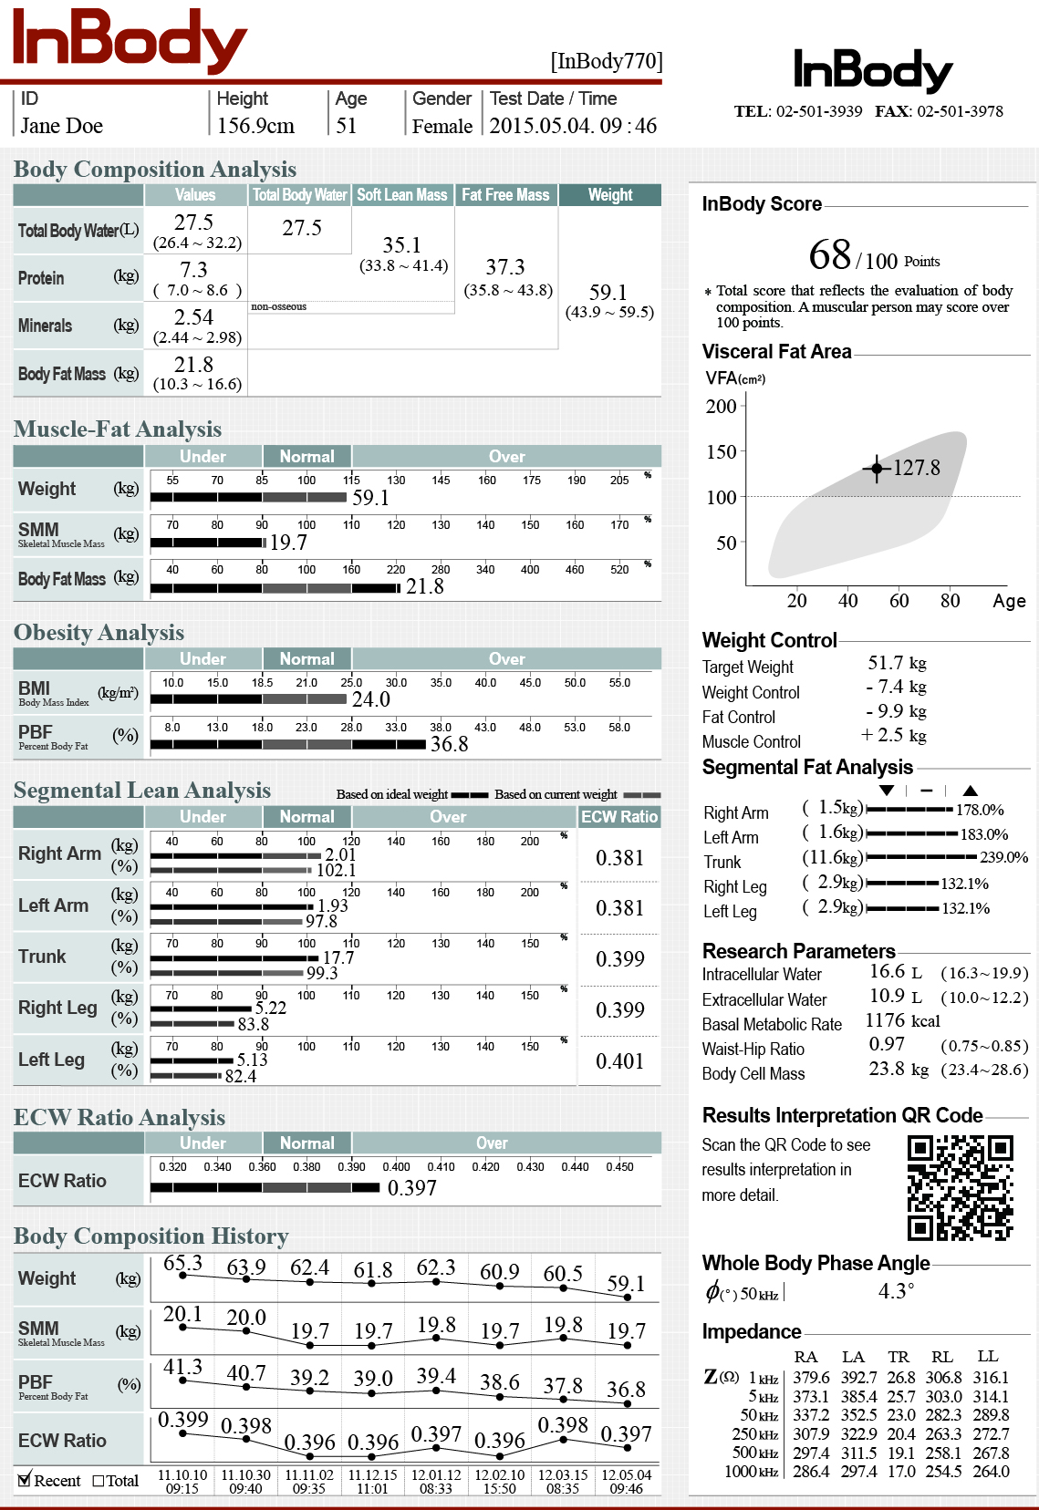
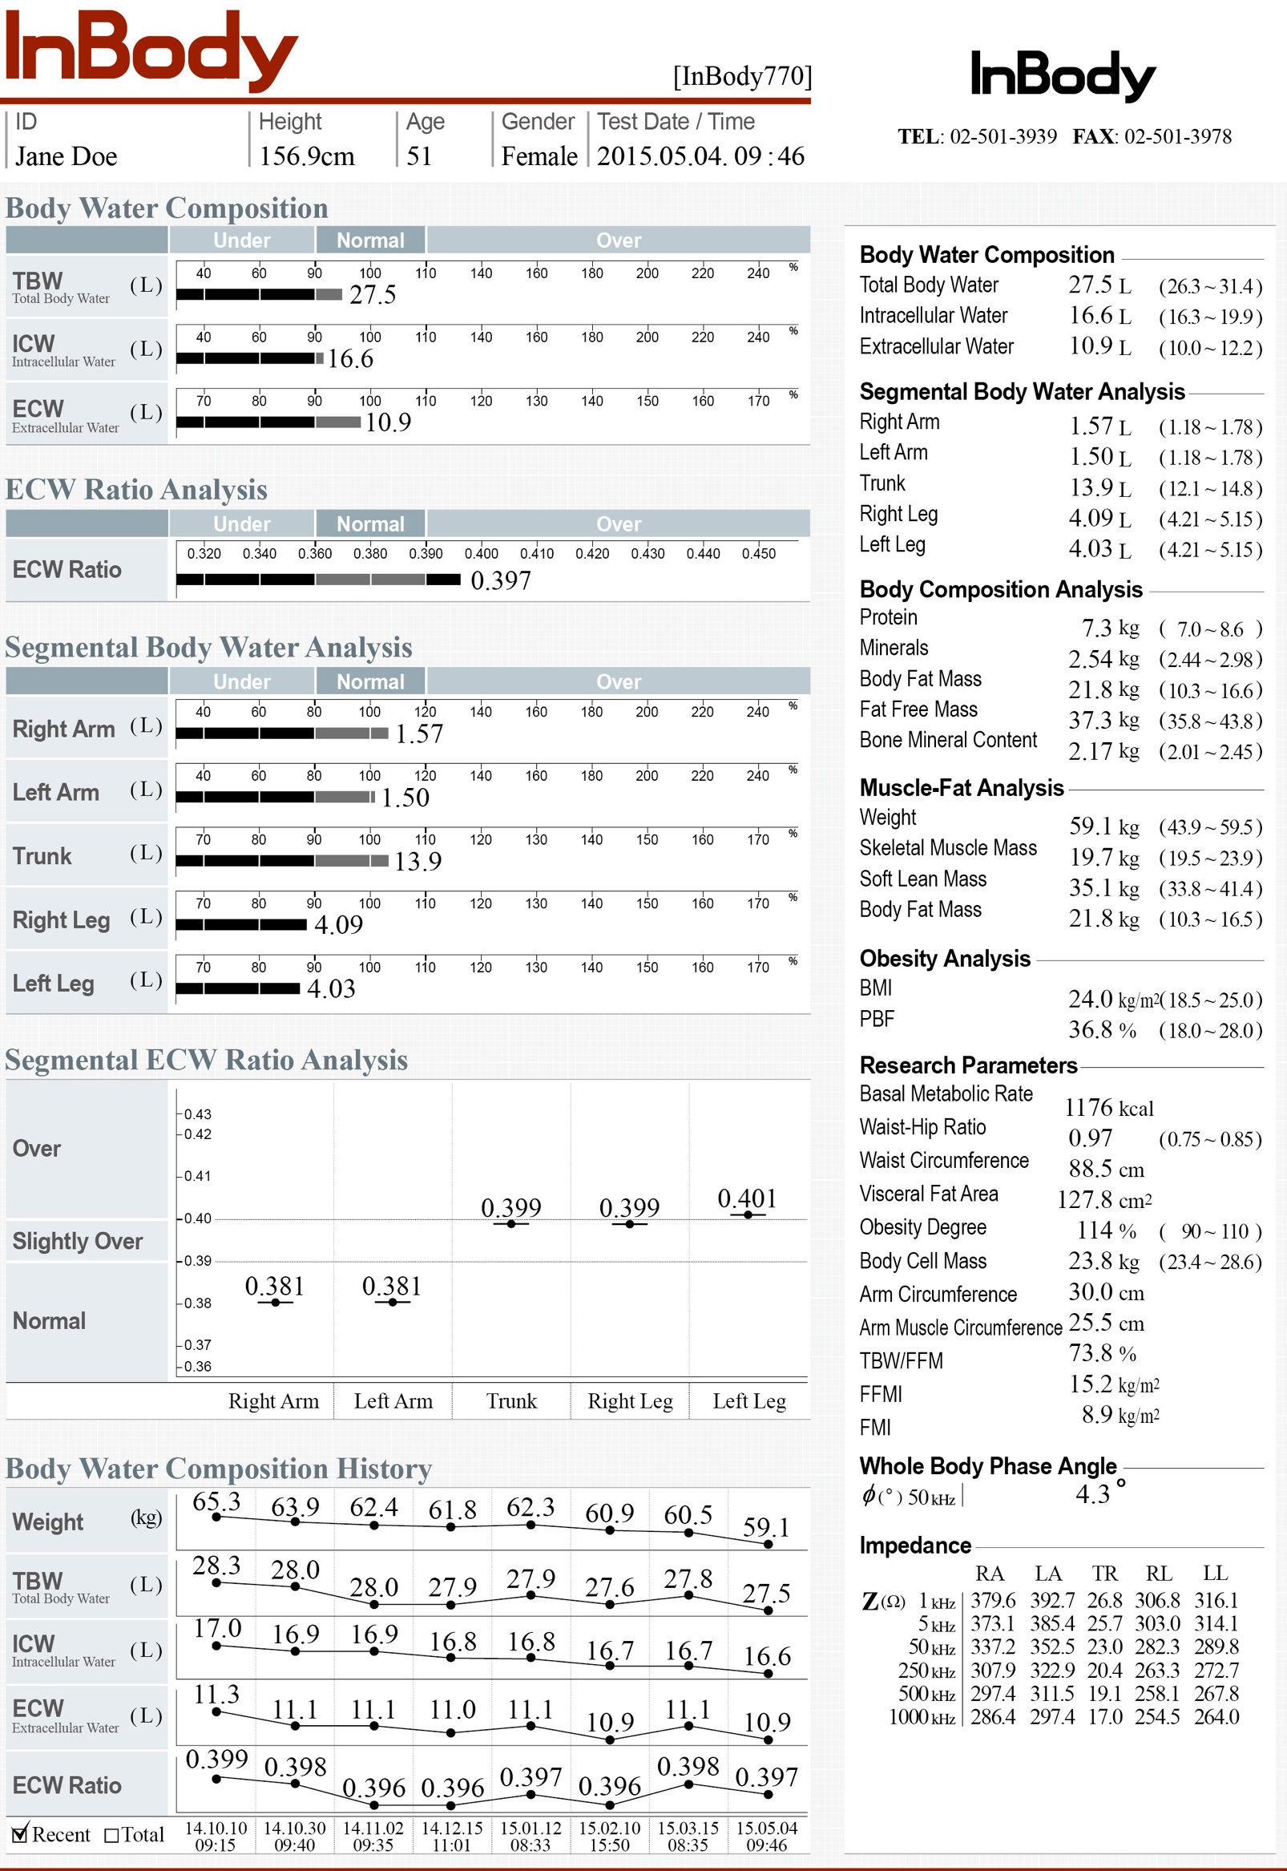
Body Water Result Sheet

Slide 21

Body Composition |  | Subjects | Symptoms | Parameter provided by InBody | Application
Screening | Risk of Diabetes | Pre-diabetes | Low Muscle | SMM (Skeletal Muscle Mass) | Insulin resistance(sensitivity) related to low muscle mass
 |  |  | High Body Fat | PBF(Percent Body Fat), VFA(Visceral Fat Area) | Obesity Evaluation
Monitoring | Muscle Wasting Disease | DM patients | Muscle Decrease | SMI (Skeletal Muscle Index) | Sarcopenia Evaluation
 | Risk of Complications |  | Lower limb Edema | Segmental ECW ratio | Prevention of progress to dialysis due to diabetes complications
Motivating | Motivation for patients to | DM patients | To motivate patients / people from understanding their risks for diabetes and complications that can occur with diabetes.

Slide 22
Thank you

